Slide 1

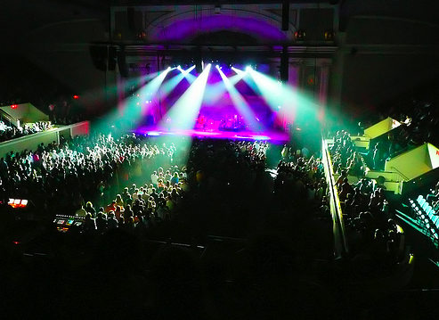


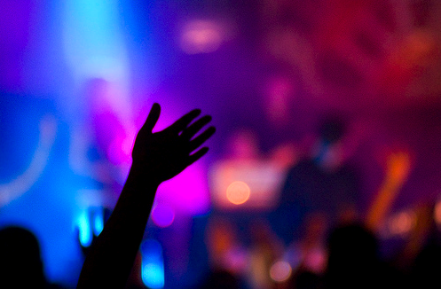
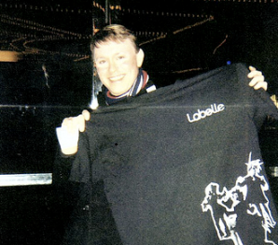

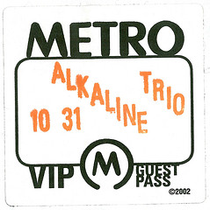

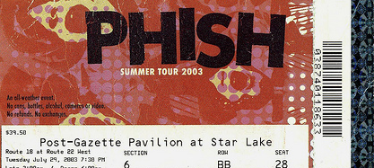
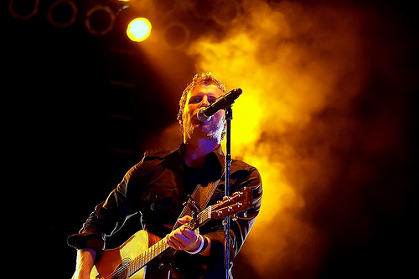



Slide 2
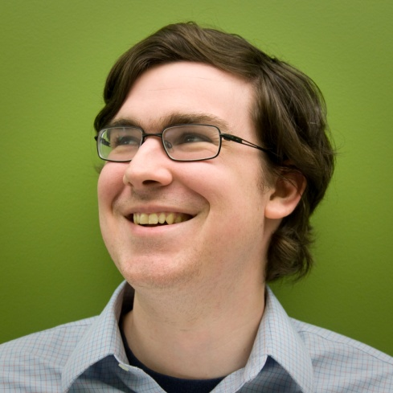
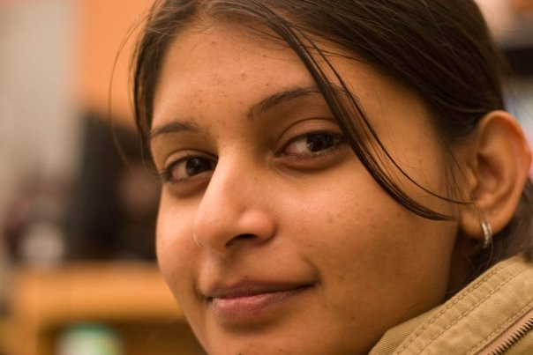
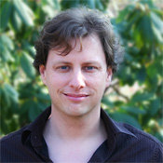
The Live Music Cast
Thomas Bolster
Kshama Nagaraja
JD Vogt

Slide 3
Our Goal
Provide an online space for people to share their experiences at live music events.

Slide 4
Our Goal
Provide an online space for people to share their experiences at live music events.
Share their Stories.
Share their Photos.

Slide 5
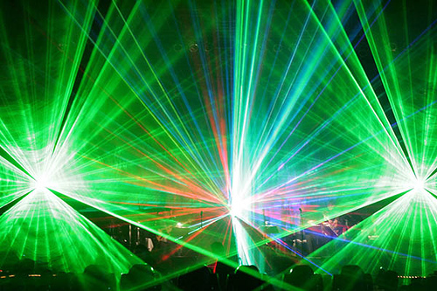
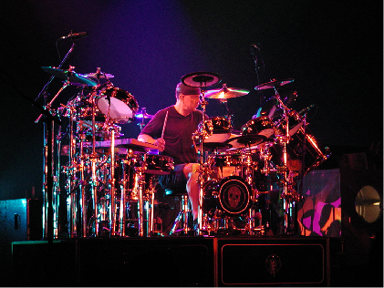
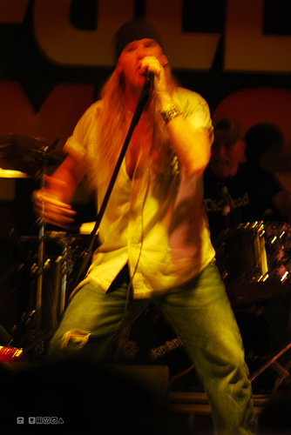
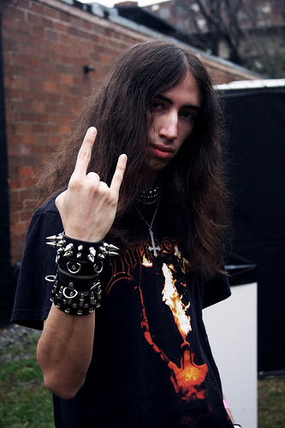
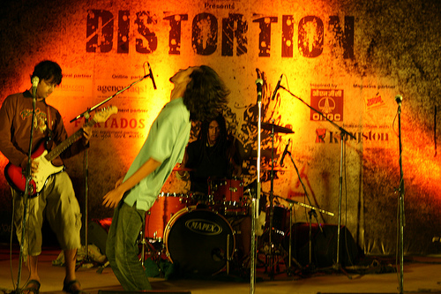
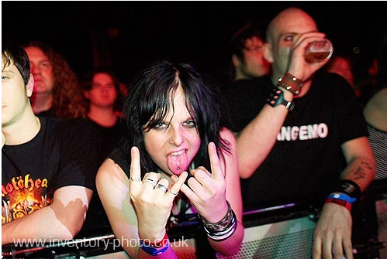
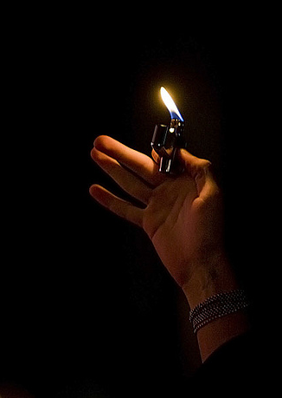
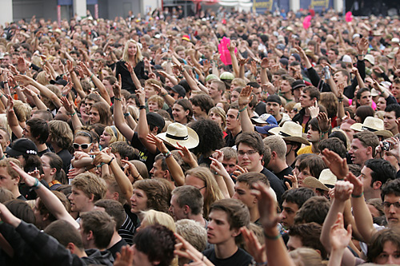
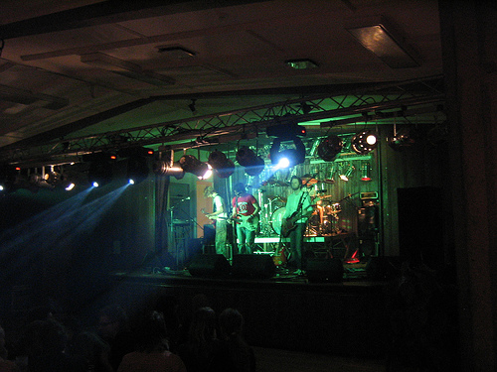

Slide 6
Our Goal
Provide an online space for people to share their experiences at live music events.
Share their Stories.
Share their Photos.
Share their Trophies.

Slide 7
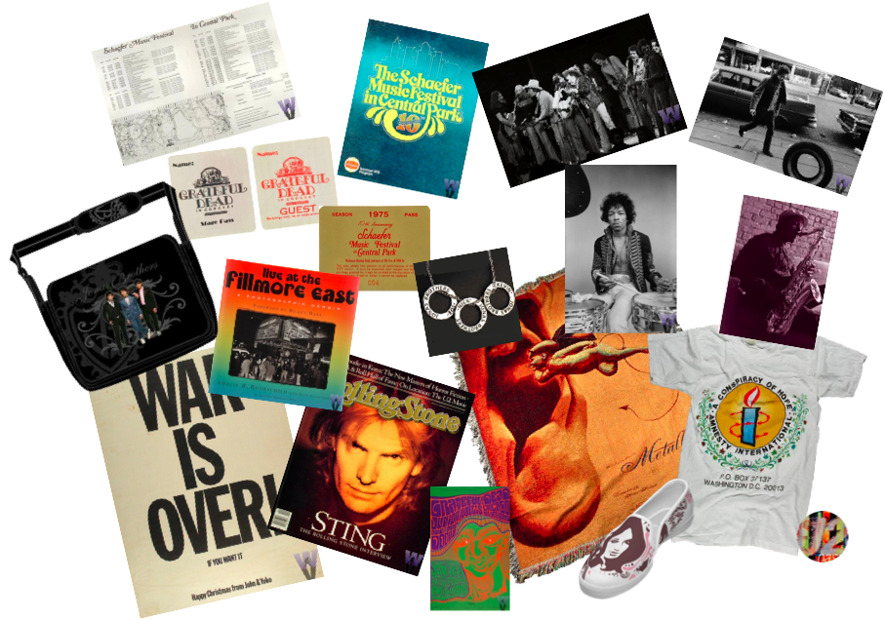

Slide 8
Our Goal
Provide an online space for people to share their experiences at live music events.
Share their Stories.
Share their Photos.
Share their Trophies.
Share their Love of Music.

Slide 9
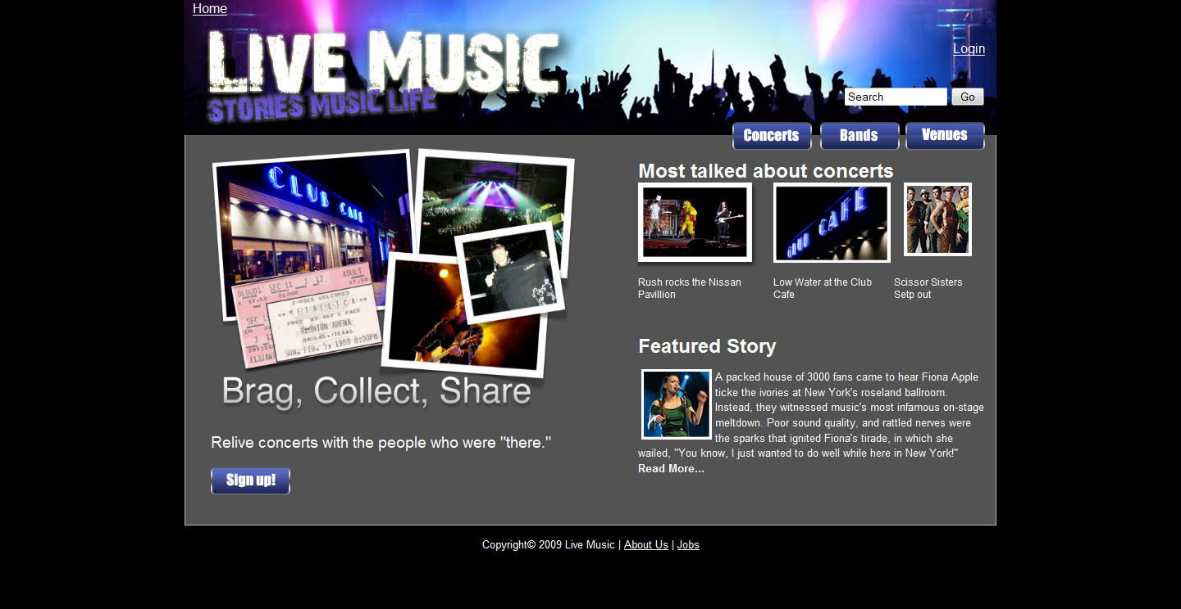
Which brings us to…

Slide 10
User Research

Slide 11


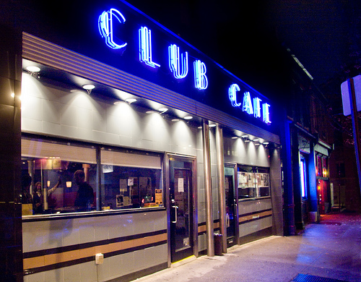
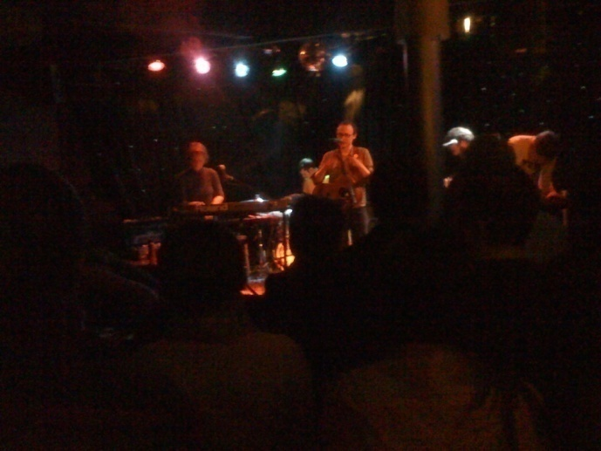

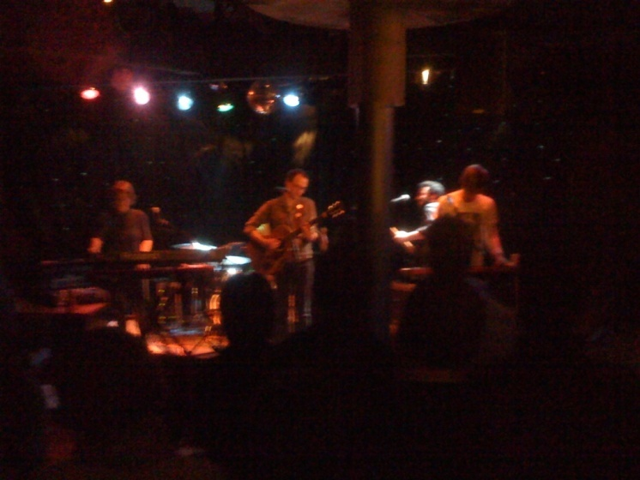
Brick and Mortar Research

Slide 12

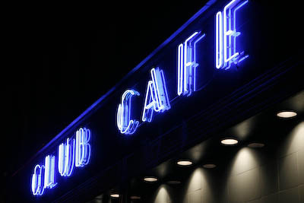
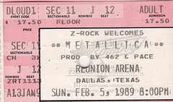
Directed Storytelling
Spoke to a total of 20 people
Good stories from about a dozen
Close-knit group

Slide 13
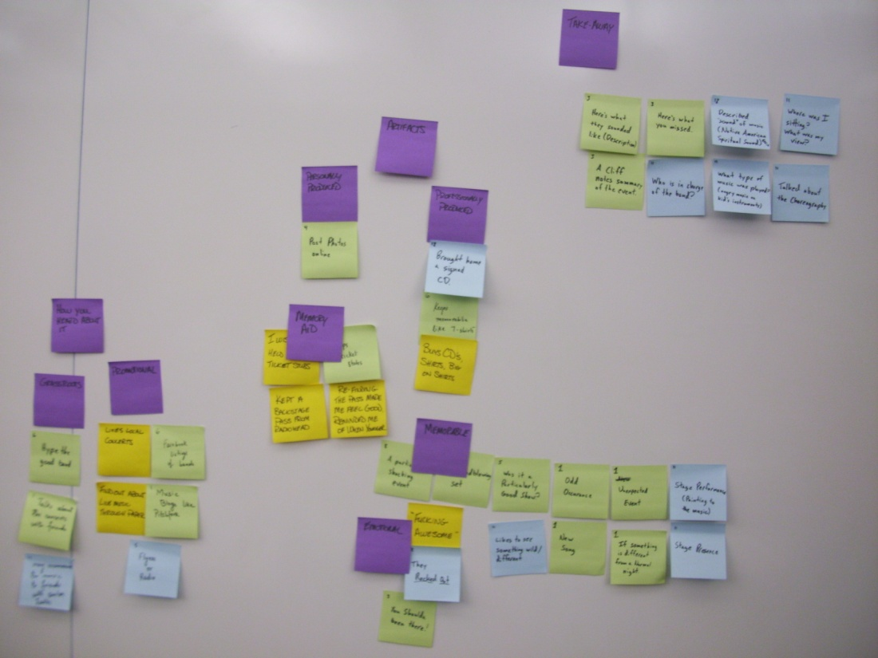
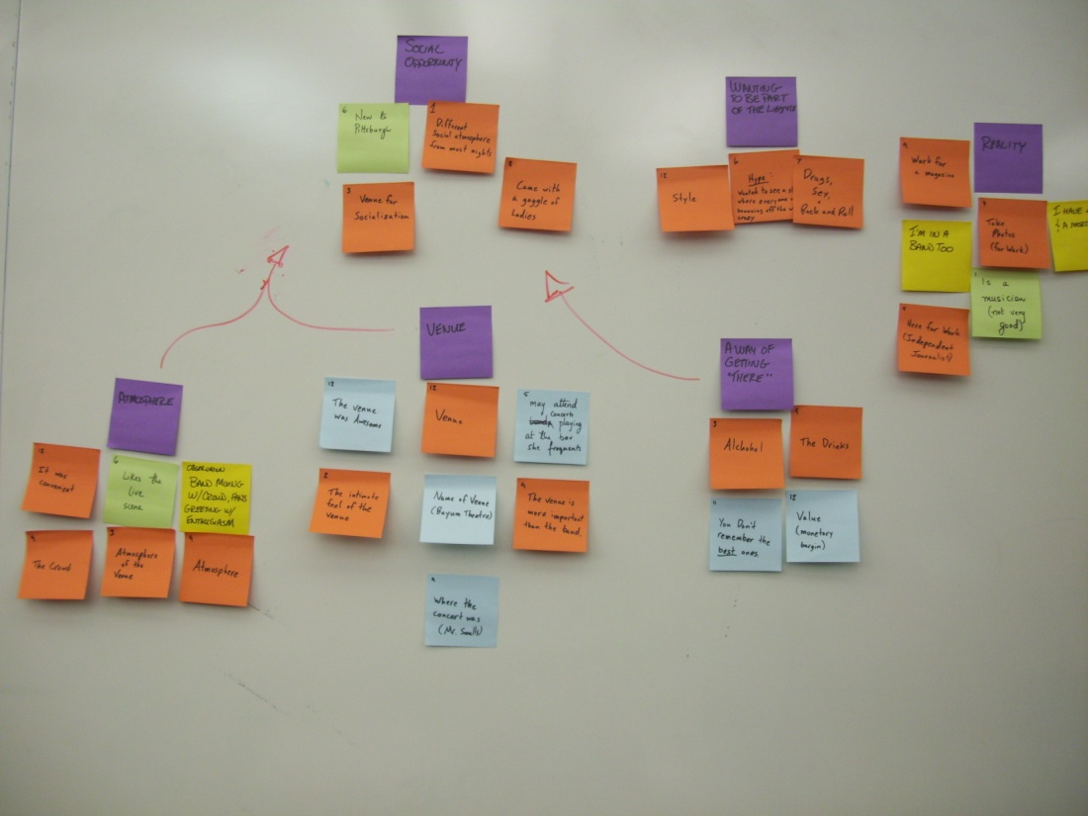
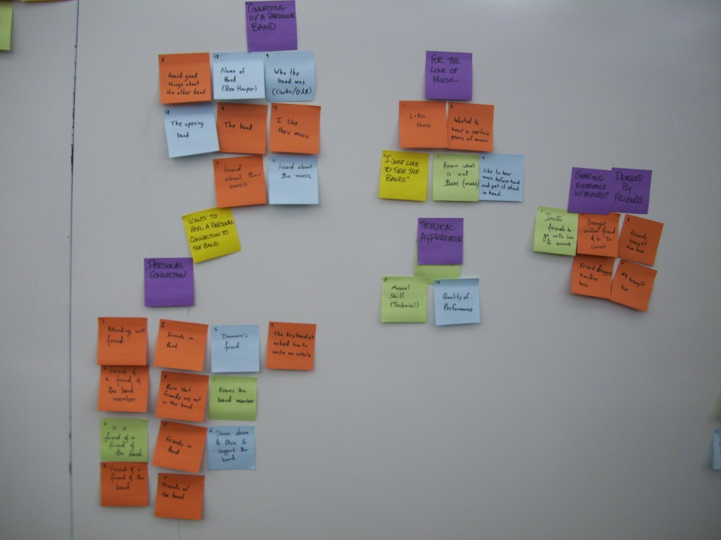
Affinity
Diagram

Slide 14
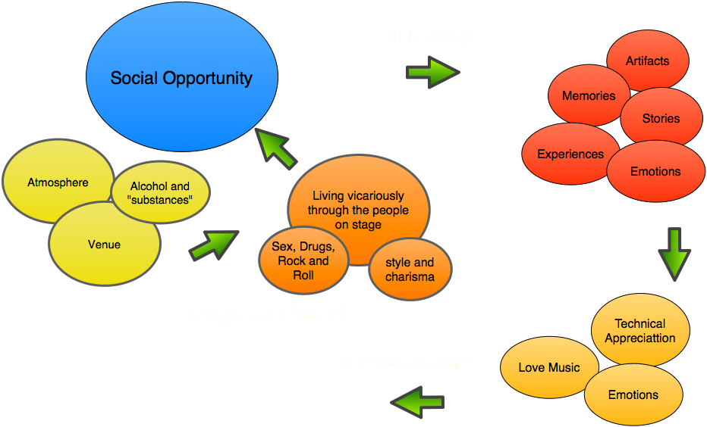

Slide 15


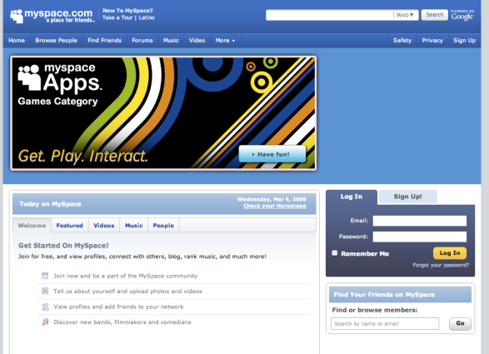
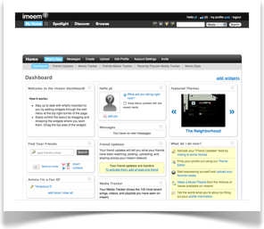

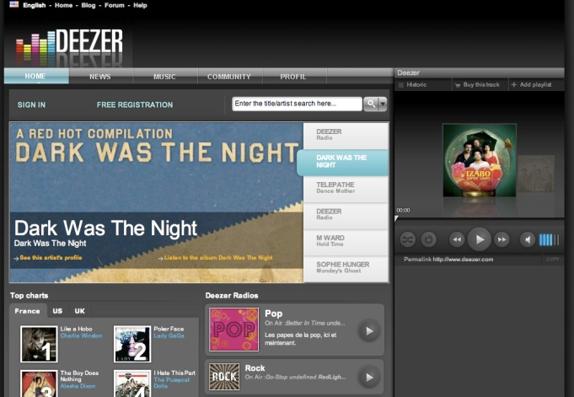
Competitive Analysis
MySpace
YouTube
Yelp
Deezer
imeem.com
Band sites and forums

Slide 16
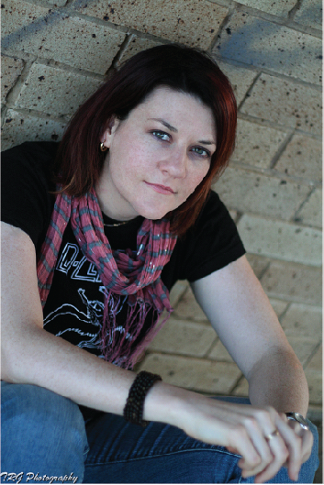
Lisa Gibbs
Age 24
Receptionist for Social Services in Washington D.C.
Considering a law degree or another type of grad school, however, currently unsure about what the next step for her is.
Enjoys socialization with friends but is often the wallflower.
Very comfortable online, sometimes more so than in real life.
She does some writing, poetry, short stories and the like.

Slide 17
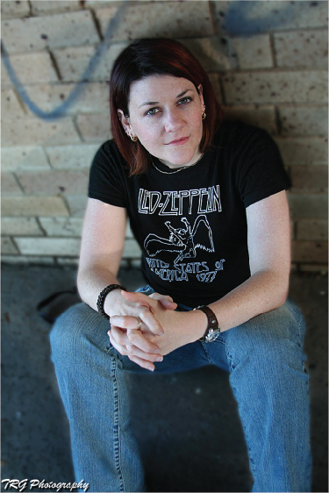
Lisa Gibbs Rocks
Several of her friends are in a local independent rock band.
Goes to their shows to show support.
Joins in on larger outings to see big name bands when they come to town.
Loves Heavy Metal music, especially Led Zeppelin.
Likes knowing all the lyrics to her favorite songs, and figuring out the meaning behind them.

Slide 18
Lisa’s Goals
Life Goals
Figure out the direction her life is going.
Wants to know her potential.
Experience Goals
Wants to express herself.
Wants to connect with her friends (and usually finds it easier online).
Low barrier to entry (get a basic site up and running quickly).
The site needs to be able to handle lots of text (as she is a verbose writer).
End Goals
Share her musical tastes
Talk about the lyrics of her favorite songs.
Find meaning in them.

Slide 19

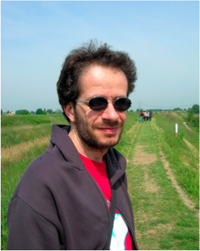
Mac Lorenzo
Age: 35
Geologist for the Department of Agriculture
Received a BS in Agricultural and Geological Sciences at University of California in Chico, CA.
Likes to barely scrape by on the edges of acceptable societal behavior.
Just bought his first house just outside of Portland, OR.
While cleaning out his house he discovered a ticket stub for an old Rush concert he had gone to in his college days. This made him very happy, as he remembered how much fun he had back in those days.

Slide 20

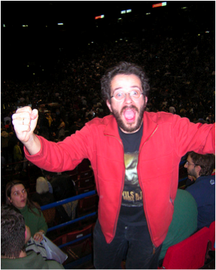
Mac Lorenzo Rocked
Mac likes to escape the mundane. A situation his current life sometimes inhibits.
While he used to get out to concerts commonly, he now must limit himself to rare occasions.
He loved the big names in classic rock as well as some of the forefront contemporary bands.
Also had an ear for jazz and electronica if the mood struck him right (or he had been drinking).
Never really enjoyed hip-hop, rap or country music.

Slide 21

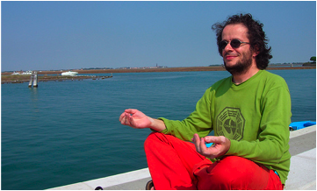
Mac’s Goals
Life Goals
Find a balance between his youth and his adult life.
Be good at what he does, in both work and play.
Experience Goals
Wants a way to personalize his space.
This is his window to his slipping youth, so he wants to be able to tend to it and tweak it. This is a hobby for him.
End Goals
Live vicariously through others who can
do what he can’t.
Doesn’t want to be a square.
Remind himself of the good times.
Help him organize outings with his friends.

Slide 22
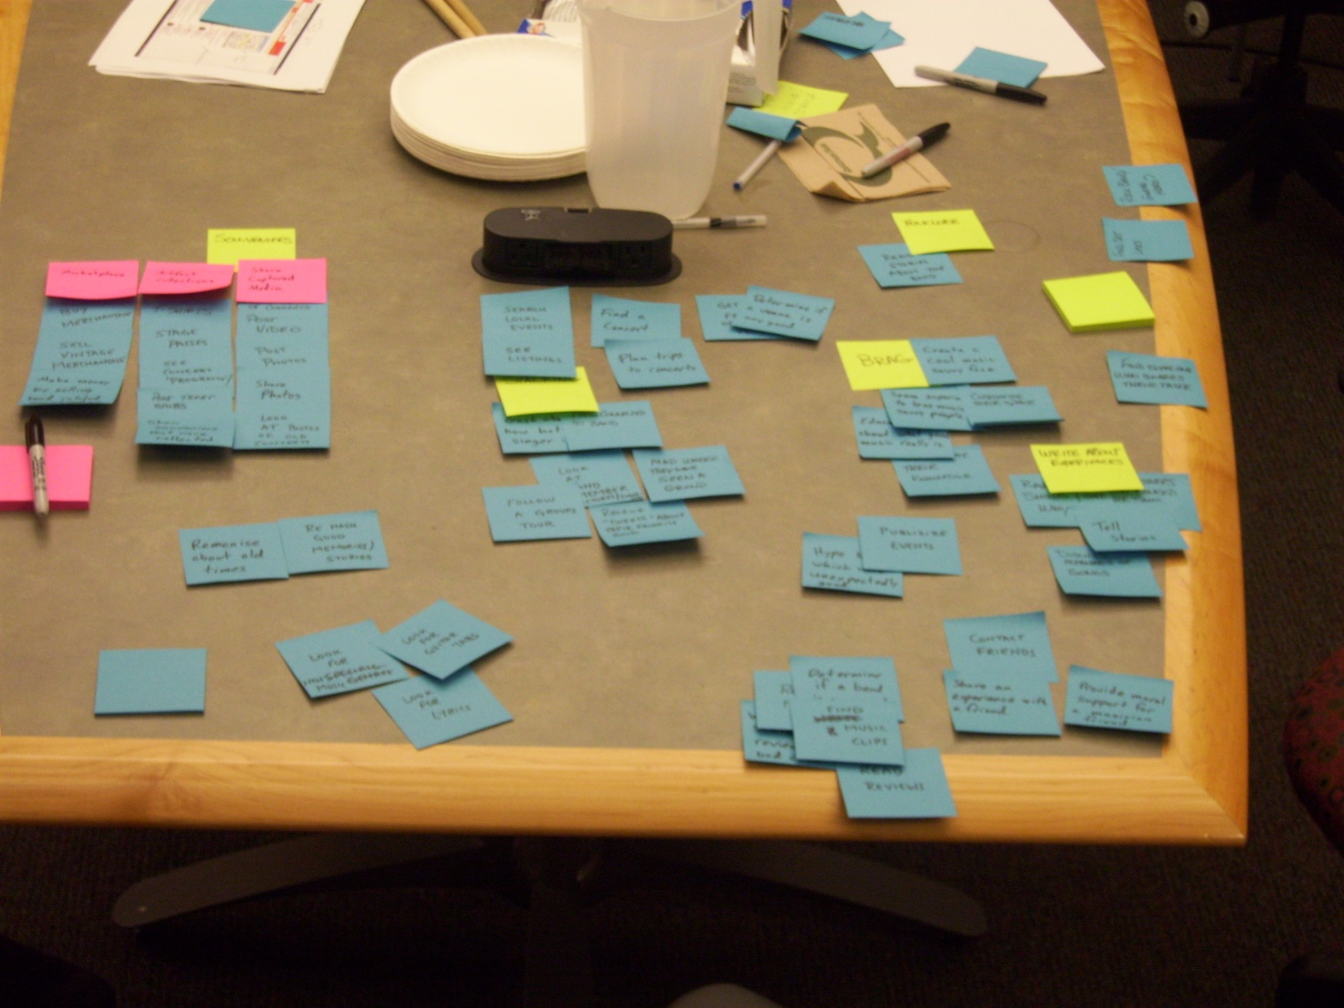
What do people want to do?

Slide 23
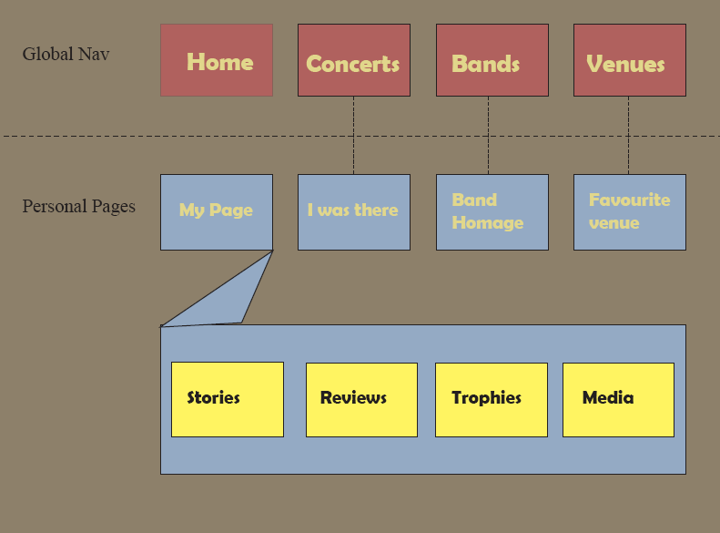
System Map

Slide 24
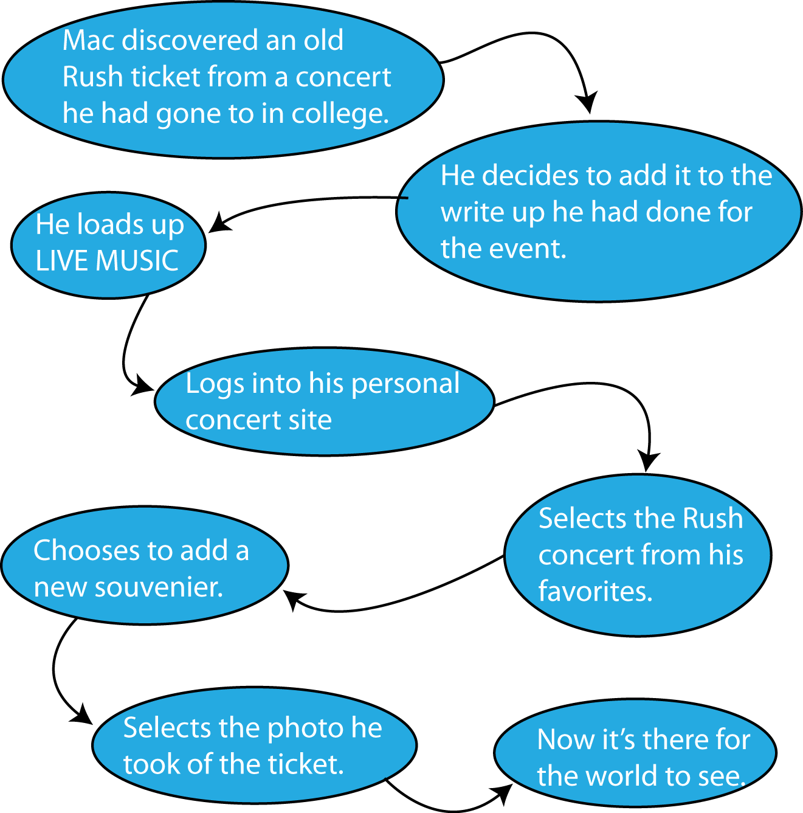
Scenario 1: Finding an old ticket

Slide 25
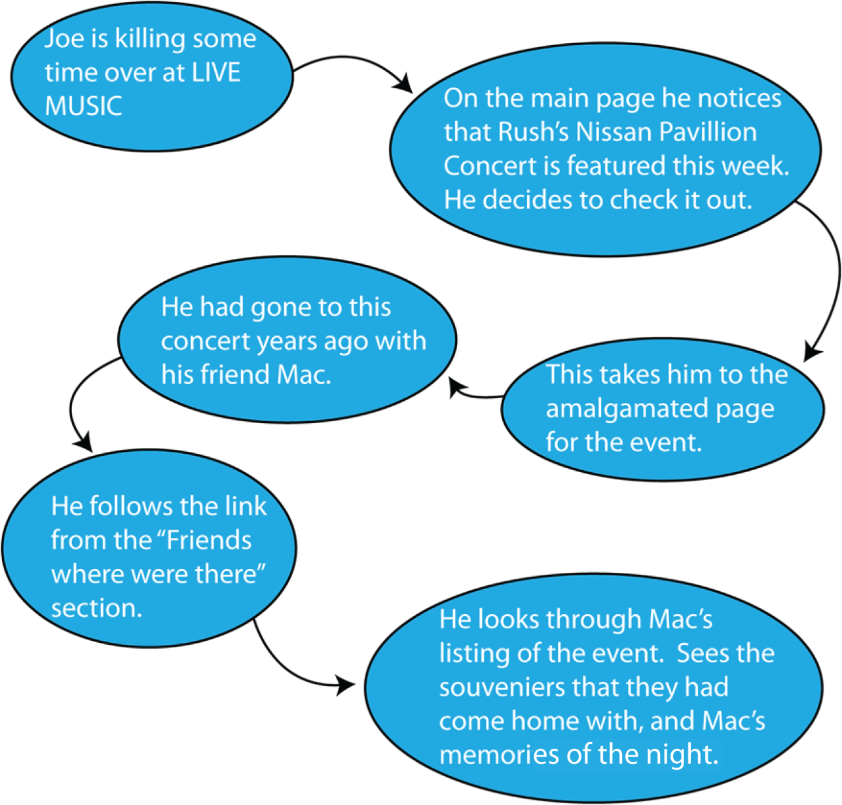
Scenario 2: Happening upon memories.

Slide 26
And Now…

